Slide 1

OLD COAT / SINNER
GREY
BLACK

Slide 2
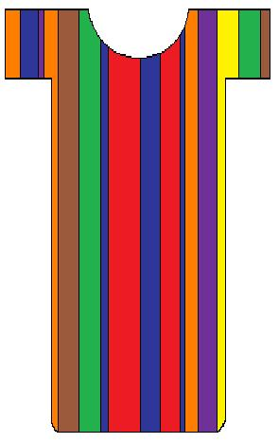
NEW COAT/ CHRISTIAN
ORANGE
YELLOW
PURPLE
GREEN
SILVER
WHITE
RED
BROWN
BLUE
& MORE!!!

